Slide 1
Fire Detection
Abdelrahman Khaled Mansour

Slide 2

Agenda
Introduction
Review Dataset
Model Architecture
Preprocessing
Segmentation
Feature Extraction
Classification
Accuracy
Test

Slide 3
Introduction
Dataset:
Two folders: "Fire Image" and "Non Fire Image," containing images for training and validation.
Objective:
Detect whether an input image belongs to the
"Fire Image" class or the "Non Fire Image" class.

Slide 4
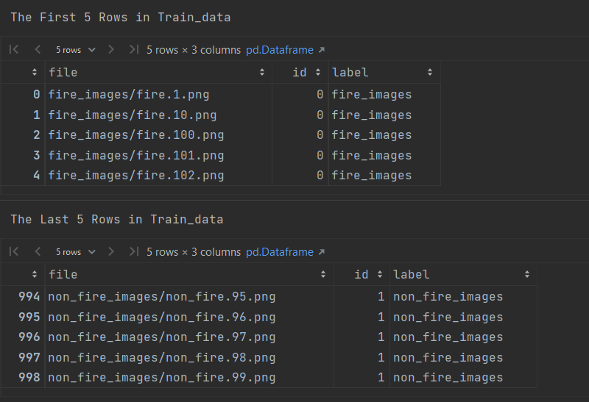
Review Dataset

Slide 5
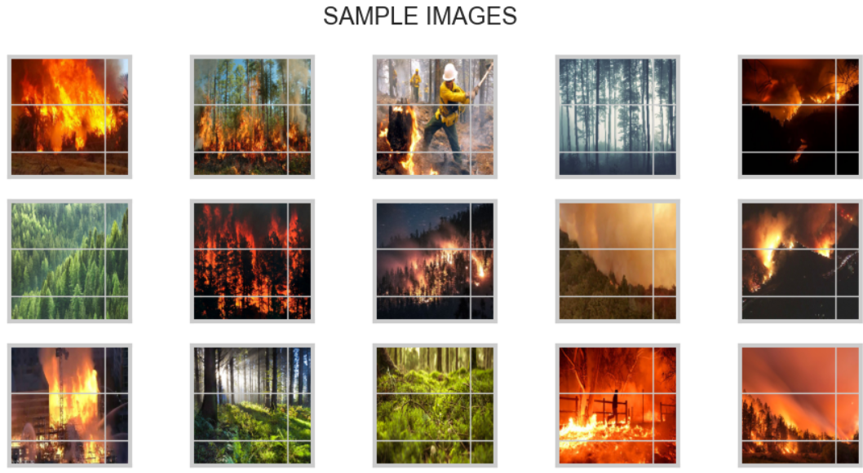
Sample

Slide 6
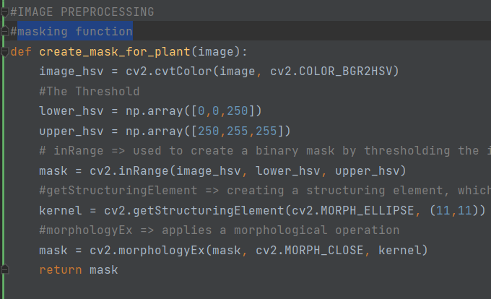
Preprocessing
Making Masking , Sharpen

Slide 7
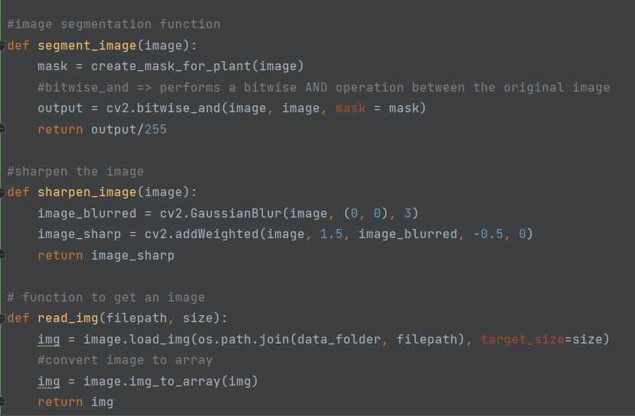
Segmentation

Slide 8
Model Architecture
Two separate deep learning models are constructed:
Model with Dropout for Histogram-based features (model1).
Model with Dropout for GLCM-based features (model2).

Slide 9
Feature Extraction
Histogram-based Features:
Extracted using the extract_histogram_features function.
Focus on the distribution of pixel intensities, providing information about overall brightness and color composition.
GLCM-based Features:
Extracted using the extract_glcm_features function.
Focus on the spatial relationships between pixel intensities, capturing patterns and texture information.

Slide 10
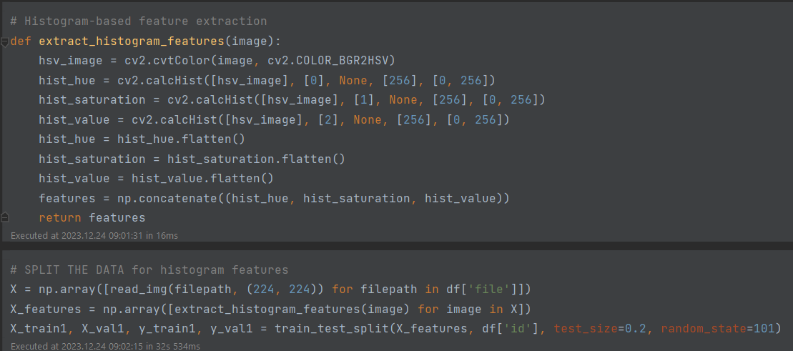
Histogram

Slide 11
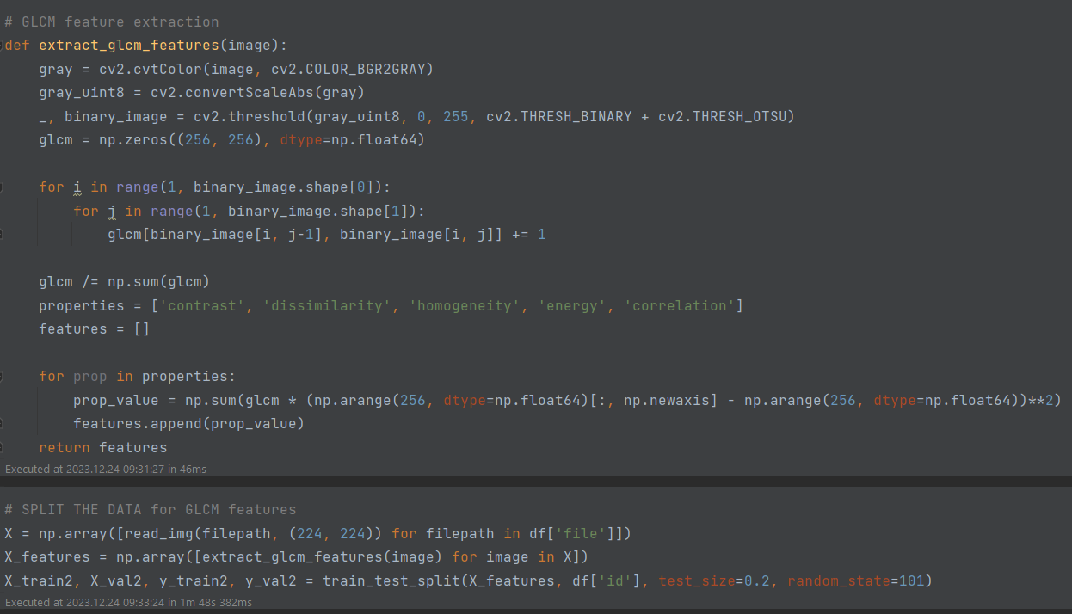
GLCM

Slide 12
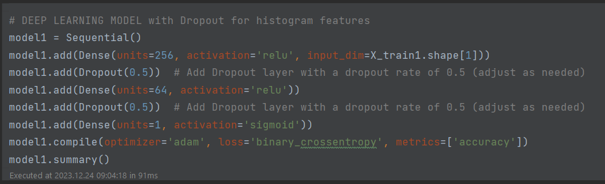
Deep Learning Model Histogram

Slide 13
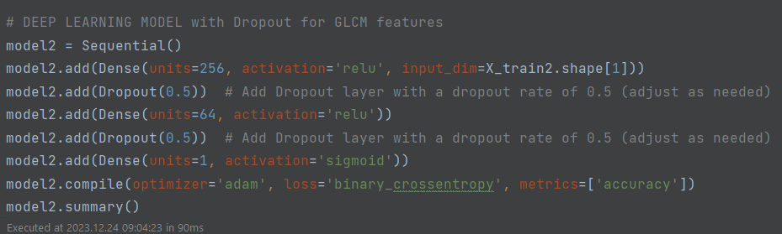
Deep Learning Model GLCM

Slide 14
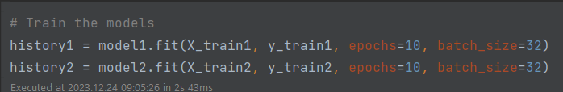
Train

Slide 15
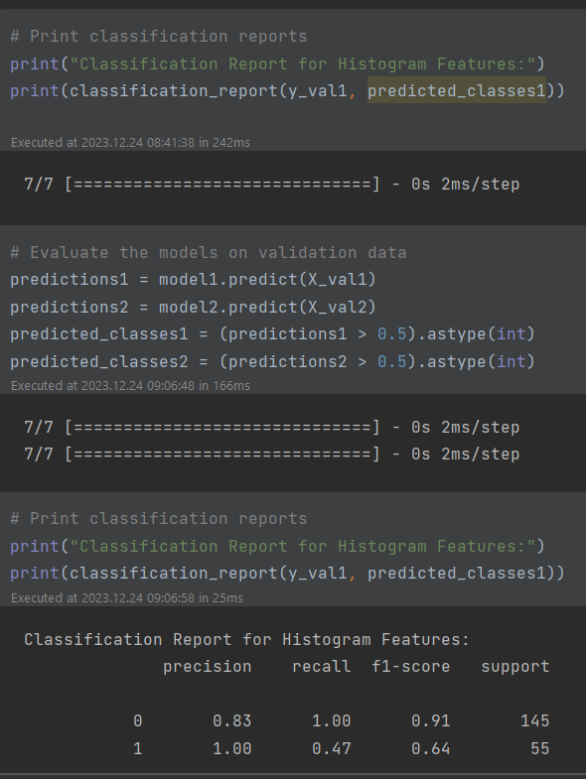
Classification

Slide 16
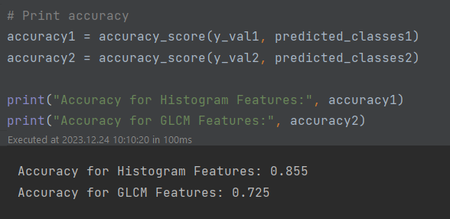
Accuracy

Slide 17
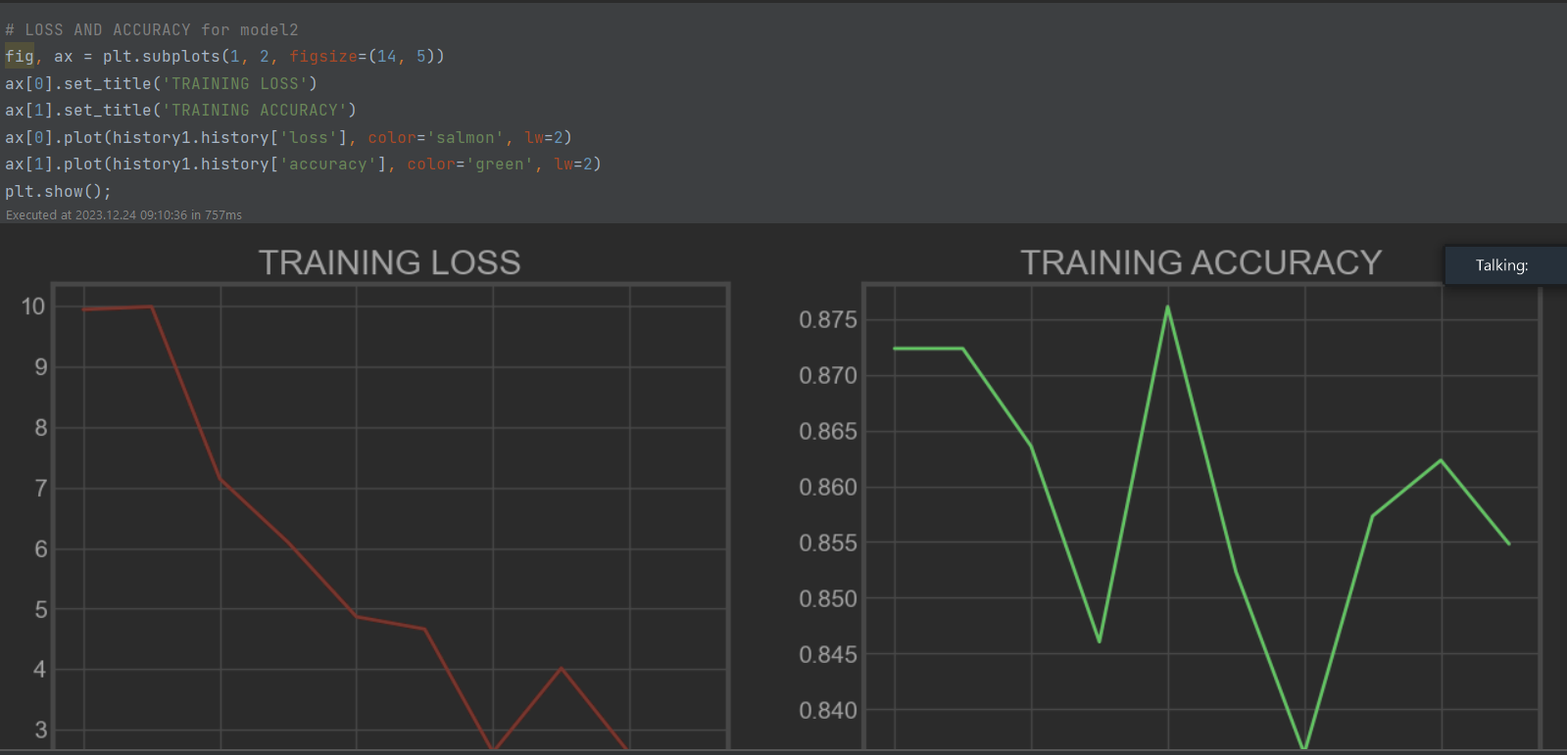
Accuracy Histogram

Slide 18
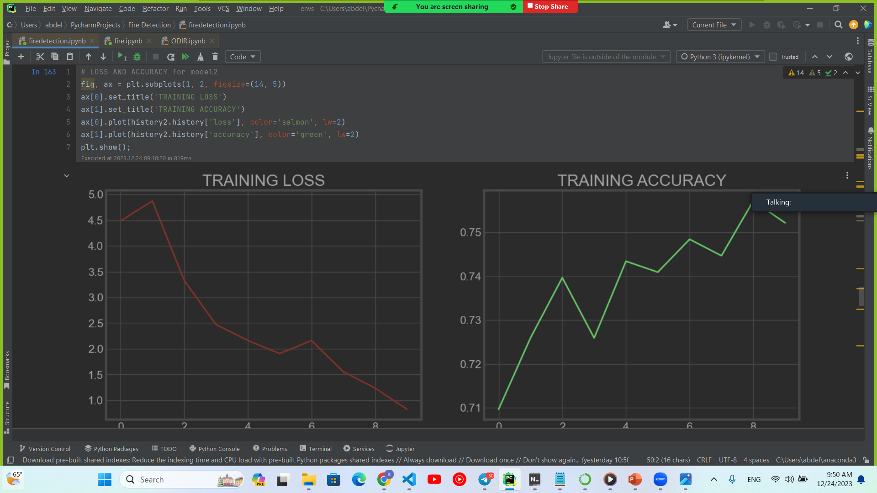
Prediction GLCM

Slide 19
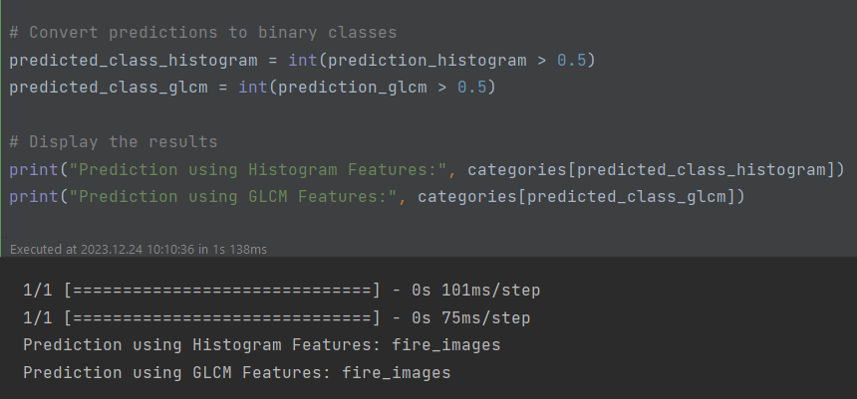
Test

Slide 20
Thank you

